Slide 1
Secure Data Hiding in Image Using Steganography
CAPSTONE PROJECT
Presented By: Syed Lateef
Student Name : Syed Lateef
College Name & Department : Nawab Shah Alam Khan College Of Engineering And Technology ( CSE IOT AND CYBERSECURITY)

Slide 2
OUTLINE
Problem Statement
Technology used
Wow factor
End users
Result
Conclusion
Git-hub Link
Future scope

Slide 3
Problem Statement
Data Privacy and Security: Traditional encryption methods make hidden data obvious, while steganography allows covert communication by concealing messages within digital media, ensuring enhanced secrecy.
Threats from Cyber Attacks: With increasing cyber threats, sensitive data needs additional protection against interception and unauthorized access, making steganography a crucial technique.
Efficient Information Hiding: There is a need for robust steganographic methods that ensure high payload capacity while maintaining image quality to avoid detection.
Prevention of Data Tampering: Steganography provides a means to embed verification data within media files, preventing tampering and ensuring data integrity.

Slide 4
Technology used
Programming Language:
Python – Used for implementing the steganography algorithm and handling image processing.
Image Processing Library:
OpenCV (cv2) – To read, manipulate, and save images in various formats.
Graphical User Interface (Optional):
Tkinter – For creating a user-friendly interface to encode and decode messages.
Data Encoding & Decoding:
LSB (Least Significant Bit) Steganography – A technique to embed data in the least significant bits of image pixels.
File Handling & Security:
NumPy – To efficiently manipulate pixel values.
Cryptography (Optional) – For encrypting the message before hiding it.

Slide 5
Wow factors
Invisible Data Hiding 🎭
The message is embedded within the image without any visible changes, making it undetectable to the human eye.
Secure Message Encryption 🔐 (Optional Enhancement)
You can add AES encryption before encoding the message, making it impossible to extract without the correct decryption key.
Cross-Format Steganography 🖼️
Supports multiple image formats (PNG, JPG, BMP), allowing flexibility in usage.
Password-Protected Extraction 🛡️
Even if someone gets the image, they cannot retrieve the message without the correct password.
Real-World Application 🌍
Used in cybersecurity, digital forensics, secret communication, and watermarking to protect sensitive data.

Slide 6
End users
Cybersecurity Professionals & Ethical Hackers 🛡️
Use steganography for secure communication and forensic investigations.
Government & Military Agencies 🏛️
Exchange confidential messages without raising suspicion.
Journalists & Whistleblowers 📰
Protect sensitive information while avoiding censorship.
Corporate Organizations & Researchers 💼
Secure intellectual property, patents, and classified data.
Digital Forensics & Law Enforcement 👮‍♂️
Detect hidden messages in cybercrime investigations.

Slide 7
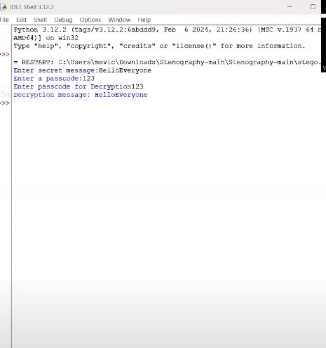
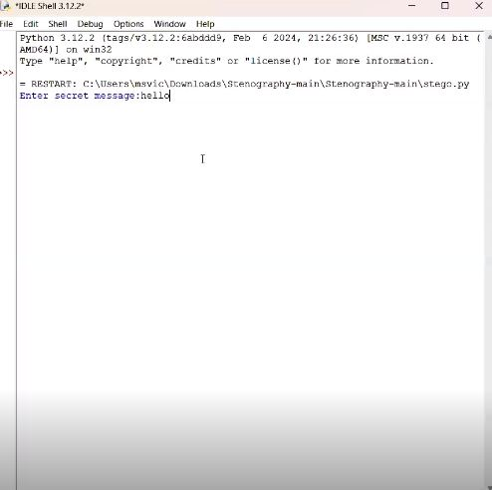
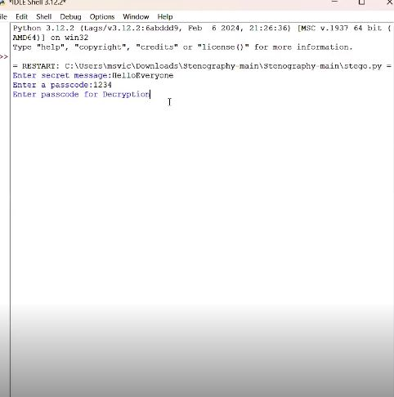
Results

Slide 8
Conclusion
Steganography provides a powerful method for secure communication by hiding data within digital media. This project demonstrates how sensitive information can be embedded within images using the Least Significant Bit (LSB) technique, ensuring confidentiality and discretion. With growing cybersecurity concerns, steganography plays a crucial role in protecting data from unauthorized access.
By implementing this project, we gain insights into real-world applications of data security, encryption, and hidden communication. Future enhancements could include stronger encryption, support for different file formats, and AI-driven detection mechanisms to further improve security. 🔐🚀

Slide 9
GitHub Link
https://github.com/syedeys/steog-project.git

Slide 10
Future scope(optional)
Future Scope of the Steganography Project 🚀
Enhanced Security with Encryption 🔐
Integrating cryptographic techniques like AES or RSA before embedding data will add an extra layer of security.
Support for Multiple File Formats 📁
Extending steganography to hide data in audio, video, and document files (PDF, DOCX) will increase its versatility.
AI-Powered Steganalysis Detection 🤖
Implementing machine learning models to detect and counter steganographic threats will enhance cybersecurity applications.
Cloud-Based Steganography ☁️
Developing a web-based or cloud-integrated platform for secure steganographic communication can facilitate remote use cases.
Blockchain Integration ⛓️
Using blockchain technology to verify and track hidden messages will add transparency and immutability to secure data exchanges.

Slide 11
THANK YOU

